Slide 1
Public Goods and Common Resources
CHAPTER 11
Notes:
N. Gregory Mankiw Principles Of Economics Eight Edition

Slide 2
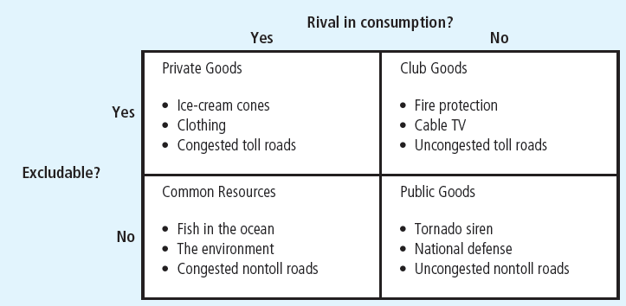
Figure 1 Four Types of Goods
Goods can be grouped into four categories according to two characteristics:
A good is excludable if people can be prevented from using it.
A good is rival in consumption if one person’s use of the good diminishes other people’s use of it.
This diagram gives examples of goods in each category.

Slide 3
Public Goods, Part 1
Free rider
Person who receives the benefit of a good but avoids paying for it
The free-rider problem
Public goods are not excludable
Prevents the private market from supplying the goods
Market failure

Slide 4
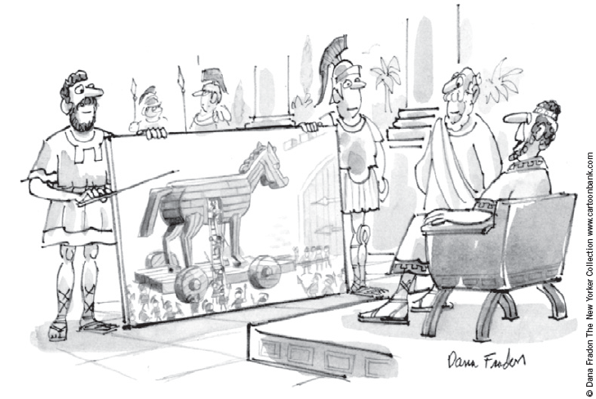
Public Goods, Part 2
Government can remedy the free-rider problem
If total benefits of a public good exceeds its costs
Provide the public good
Pay for it with tax revenue
Make everyone better off
“I like the concept if we can do it with no new taxes.”

Slide 5

Are lighthouses public goods?, Part 1
Lighthouses
Mark specific locations so that passing ships can avoid treacherous waters
Benefit: to the ship captain
Not excludable, not rival in consumption
Incentive: free ride without paying
Most are operated by the government
What kind of good is this?

Slide 6
Are lighthouses public goods?, Part 2
In some cases
Lighthouses are closer to private goods
Coast of England, 19th century
Lighthouses were privately owned and operated
The owner of the lighthouse charged the owner of the nearby port
If the port owner did not pay, lighthouse owner turned the light off: ships avoided that port

Slide 7
Are lighthouses public goods?, Part 3
Decide whether something is a public good
Determine who the beneficiaries are
Determine whether the beneficiaries can be excluded from using the good
A free-rider problem
When the number of beneficiaries is large
Exclusion of any one of them is impossible

Slide 8
How much is a life worth?, Part 1
Cost: $10,000 for a new traffic light
Benefit: increased safety
Risk of a fatal traffic accident
Drops from 1.6 to 1.1%
Obstacle
Measure costs and benefits in the same units
Put a dollar value on a human life?
Priceless = infinite dollar value

Slide 9
How much is a life worth?, Part 2
Implicit dollar value of a human life
Courts: award damages in wrongful-death suits
Total amount of money a person would have earned if he or she had lived
Ignores other opportunity costs of losing one’s life
Risks that people are voluntarily willing to take and how much they must be paid for taking them
Value of human life = $10 million

Slide 10
How much is a life worth?, Part 3
Cost–benefit analysis
Traffic light
Reduces risk of fatality by 0.5 percentage points
Expected benefit = 0.005 × $10 million = $50,000
Cost ($10,000) < Benefit ($50,000)
Approve the traffic light

Slide 11
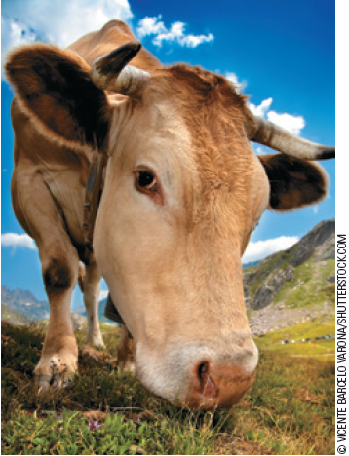
Why the cow is not extinct, Part 1
Animals with commercial value that are threatened with extinction
Buffalo
North America
Hunting in the 19th century
Elephants
African countries
Hunting today
“Will the market protect me?”

Slide 12
Why the cow is not extinct, Part 2
The cow
Commercial value
Species continues to thrive
Cows are a private good
Ranches are privately owned
Rancher: great effort to maintain the cattle population on his ranch
Reaps the benefit

Slide 13
Why the cow is not extinct, Part 3
Elephant - common resource
Poachers are numerous
Strong incentive to kill elephants
Government of Kenya, Tanzania, and Uganda
Illegal to kill elephants and sell ivory
Hard to enforce laws
Decreasing population of elephants

Slide 14
Why the cow is not extinct, Part 4
Government of Botswana, Malawi, Namibia, and Zimbabwe
Made elephants a private good
People can kill elephants on their own property
Landowners have an incentive to preserve the species
Elephant populations have started to rise

Slide 15
Importance of Property Rights, Part 1
Market fails to allocate resources efficiently
Because property rights are not well established
Some item of value does not have an owner with the legal authority to control it

Slide 16
Importance of Property Rights, Part 2
The government can potentially solve the problem
Help define property rights and thereby unleash market forces
Regulate private behavior
Use tax revenue to supply a good that the market fails to supply

